Slide 1
ELECTRICAL SCIENCE-1
(15B11EC111)
UNIT-2
Lecture-5

Slide 2
Topics to be Discussed
Nodal analysis
Practice Problem
References

Slide 3
Nodal Analysis

Slide 4
Node-Pair Voltages Analysis
It involves the application of KCL equations, instead of KVL.
One of the nodes is taken as reference or datum node. It is better to select the one that has maximum number of branches connected.
The reference node is assumed to be at ground or zero potential.

Slide 5
Contd..
The potentials of all other nodes are defined w.r.t. the reference node.
KCL equations are written, one for each node, except the reference node.
The equations are solved to give node voltages.
Current through any branch and voltage at any point of the network can be calculated.

Slide 6
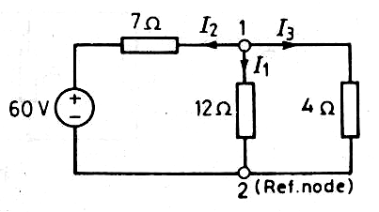
Example 1
Solve the circuit given, using the node voltage method.

Slide 7
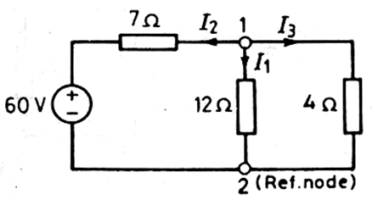
3, V3
V1
4, V1

Slide 8
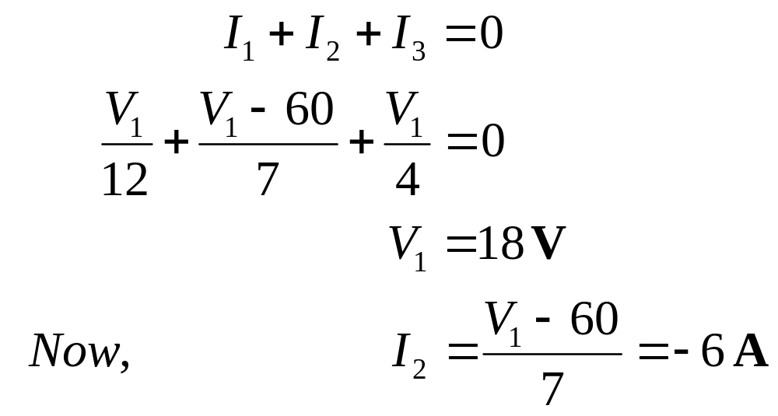
Solution : It has only two nodes. Node 2 has been taken as reference node. The currents in various branches have been assumed. Writing the KCL equations,

Slide 9
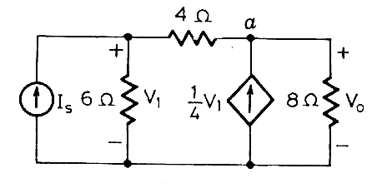
Example 2
Apply KCL to determine current I_{S} in the circuit shown. Take V_{o} = 16 V.

Slide 10
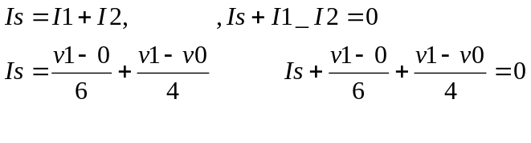
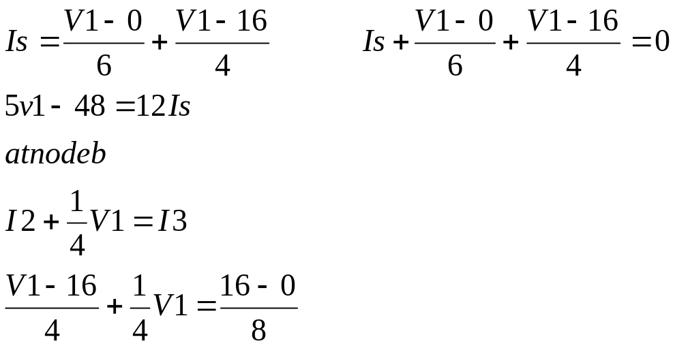
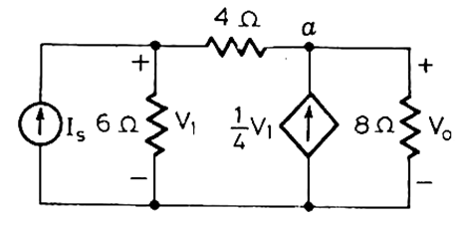
Vb=V1,
Vo=Va
I2
b, V1
Vo
I3
I1

Slide 11
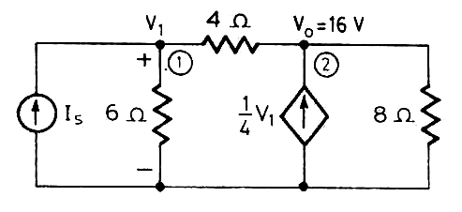

Solution : Applying KCL at nodes 1 and 2,

Slide 12

Therefore, the current,

Slide 13
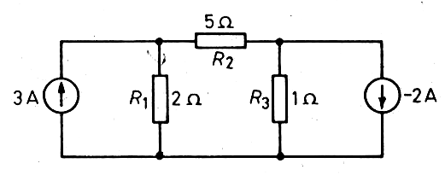
Example 3
Using nodal analysis, determine the current through the 2-Ω resistor in the network given.

Slide 14
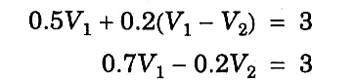

It has 3 nodes. So, we have to write KCL equations for only 2 nodes.
We just equate the total current leaving the node through several conductances to the total source-current entering the node.
At node 1,
At node 2,

Slide 15

Using Crammer’s rule, we can solve the above two equations to get the node voltages.

Slide 17

Finally, the current in the 2-Ω resistor is calculated as

Slide 18
Generalized Matrix Form of
Nodal Equations
The above examples suggests that it is possible to write the nodal analysis equations just by inspection of the network.
Network should have only independent current sources.
All passive elements be shown as conductances, in siemens (S).

Slide 19
Contd..
In case a network contains a practical voltage source, first convert it into an equivalent practical current source.
Write the Conductance Matrix, Node-Voltage Matrix and the Node-Current Source Matrix, in the same way as in the Mesh Analysis.

Slide 20
REFERENCES
[1] R.C. Dorf and James A. Svoboda, “Introduction to Electric Circuits”, 9th ed, John Wiley & Sons, 2013.

